Slide 1
Writers at Work
Activities created by Cherry Carl Artwork Licensed by www.art4crafts.com 2009

Slide 2
Writers at Work CD Contents
Thematic Activity Packet (46 pgs)
Writing Posters (36 pgs)
Report Writing Posters (17 pgs)
Shape Books (43 pgs)
Writing Centers & Menus with 45 choices
Writing Support Materials
Picture Dictionary
Summary Selections
Math Journals

Slide 3
Activity Packet Contents
Writing Word List
Letter Writing Book List
Memoir Book List
Diaries & Journals Book List
Poetry
Stationery
Writers Workshop
Writing Log
Conference Log Informational Writing
Checklists
Demonstrated Writing
Shared Writing
Letter Diary
Written Conversation
Diaries and Journals

Slide 4
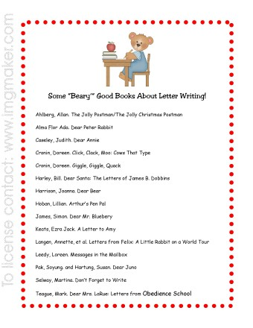
Writing Lists

Slide 5
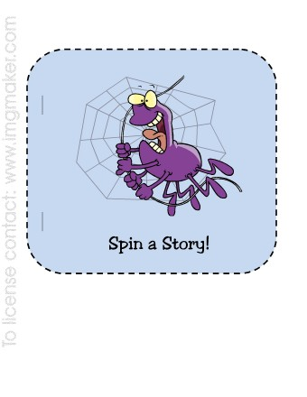
Shape Books
Holidays
Word Families
Rhyming
Initial Blends

Slide 6
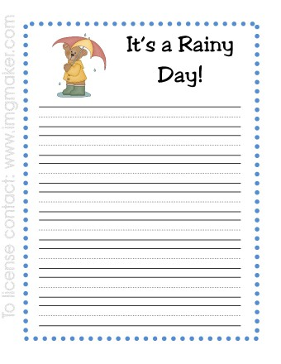
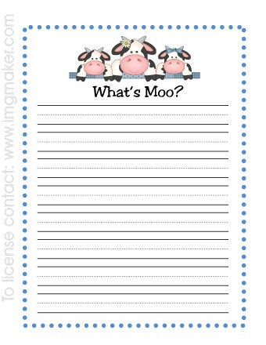
Stationery

Slide 7
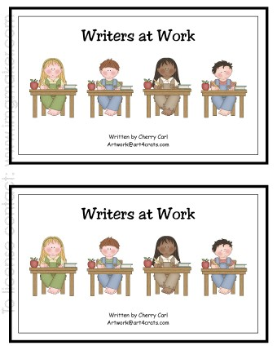
Little Readers
Writers at Work is a reproducible handwriting book that focuses on high frequency words in context. Special Spelling includes word lists for holidays, sports, numbers and other popular writing topics. My Little Book of Words for Writing contains the 300 most frequently used words for writing and is an excellent resource for young writers.

Slide 8
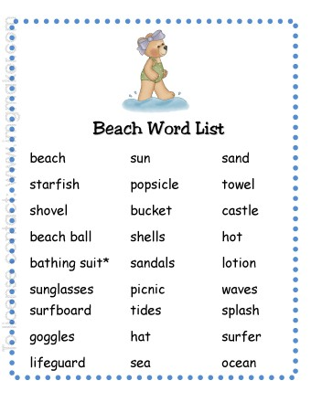
Writing Posters
35 writing posters to support early, emergent and fluent writers in the primary classroom. Topics related to popular themes covered in reading series, science and social studies. Holiday posters are also included. Use in your literacy center to facilitate writing!

Slide 9
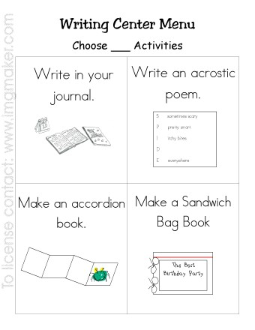
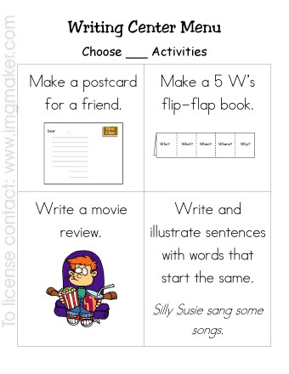
Writing Center Menus
2 of 9 pages

Slide 10
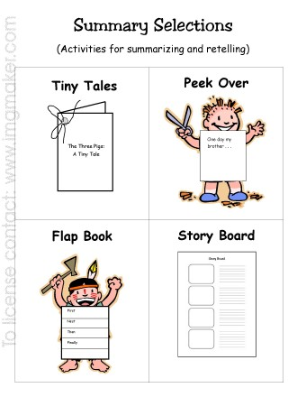
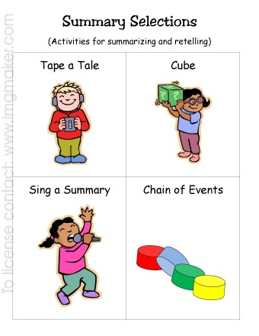
Summary Selections
2 of 7 pages

